Slide 1




GCSE Exams
Summer 2023
The Pathway to SUCCESS
Name:
___________________
Tutor Group:
____________________
#bounce

Slide 2
Introduction
Welcome to the new Pathway to Success booklet for our 2022-23 year 11 students. This booklet is designed to inform you about the upcoming exam season and provide you with the details that you need to prepare effectively and plan your own pathway to success.
Within this booklet you will find key details from each subject such as what exams you have coming up; when they are all taking place; the content you need to know for each; and also top revision tips for each written by the head of department.
This booklet provides you with a great starting point to plan out the next few months. All you need to do is revise effectively to earn your success!

Slide 3

Revision Techniques
The key to success in GCSE exams is no secret…revising effectively. However, this is often (far too often) easier said than done.
We are all individuals who learn in different ways. The key is to find what works best for you and use a range of revision techniques to keep things interesting, engaging and, most importantly, memorable!
Start revising NOW. DO NOT leave it to the last minute and DO NOT simply cram for each exam.
On the next page you will find a huge range of exam techniques that could be applied for all subjects. On subsequent pages you will also find what each head of department recommends for their subject.

Slide 4
Revision Techniques
One of THE BEST methods of revising is
Self-Testing.
This method involves a number of different revision techniques and it is, most importantly, an active form of revision.
First of all you have to summarise your learning as short flash card (cards which summarise key points). These can then be used by a friend or family member to test your knowledge and highlight areas of strength and weakness.
The great thing about this method is that it can be used for ANY subject and also created by hand or online using a website / app called Brainscape.
Examples can be seen on the next page.

Slide 5
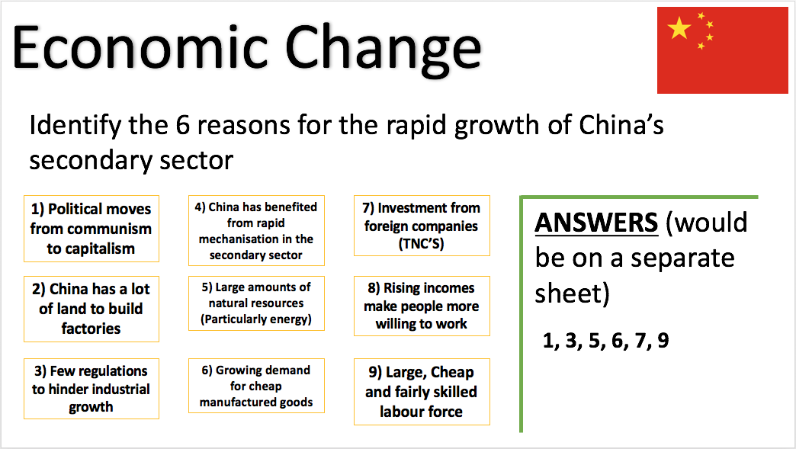
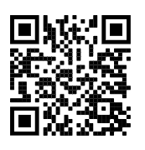
Self-Testing Example
This is an example of a Geography case study flash card that has been specifically created to allow someone to test their knowledge.
How do I make flash cards which work?

Slide 6

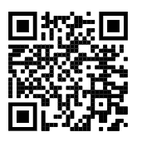
Self-Testing Brainscape
Brainscape is basically a system for creating electronic flashcards.
On Brainscape you create the questions. You then write the perfect answers. You can then test yourself as the system shows you the question and you try to answer it. You then rank your confidence with that content.
The less confident that you feel the more it will come up! Great!
Creating your own Brainscape
www.brainscape.com
Create a username
Create your subject
Create a deck of cards
Add cards
Write down a question from your chosen topic
Add the answer in
Repeat to include all content from the topic
Start studying
Read each question and then rank how well you remembered the answer on the confidence meter
The questions which you are less confident in will come up more and more as your retest
Practice with a friend / family member who can rank your confidence themselves

Slide 7

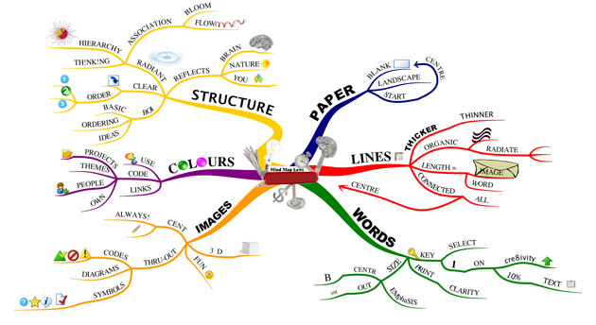
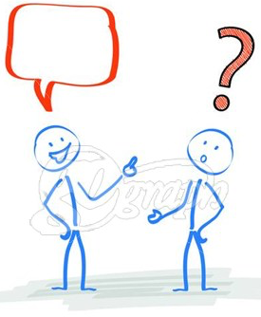


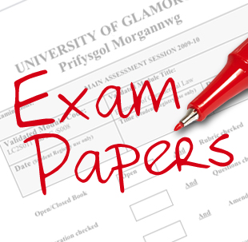

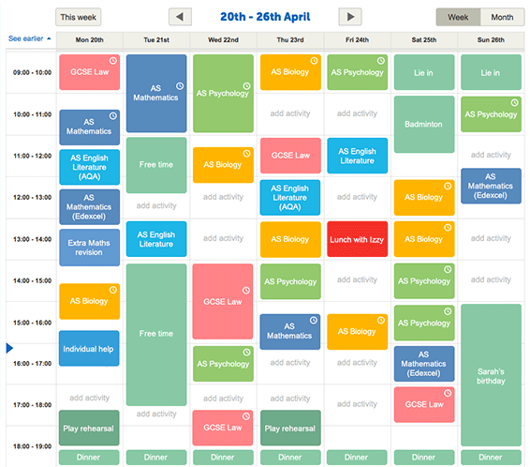

Revision Techniques
Explain a topic to a family member
Create mind maps of a particular topic gradually adding more detail as you move out from the centre
Summarise a topic’s key details on a flashcard or case study card
Highlight key content in your class book / revision guide
Use colours and images to allow your brain to make a greater number of memories for a topic
Retest yourself on practice questions or tests that you have done in class
COMPLETE PAST EXAM PAPERS
Mix up your revision time rather than revising one subject for hours
React to the feedback you have received in your class book and past tests to improve your work
Useful Revision Websites
http://www.bbc.co.uk/news/health-22565912
https://getrevising.co.uk
https://www.brainscape.com
https://www.tpssmart.com
http://www.bbc.co.uk/education/levels/z98jmp3

Slide 8





The Digital World
Over the past few years the number of quality online resources has increased significantly. Although there is often no beating the classic strategies for practice exam questions and flashcards, these online resources can be a very useful addition to your overall revision strategy.
Below you will find a list of a number of these quality resources and which lesson they could be used for.
Dr Frost Maths -
onliine platform with videos questions and past papers
Quizzes, presentations + worksheets for Science
Practice AQA vocab for MFL
An oldie, but a goodie!
An exciting online learning platform that engages students whilst developing their long term memory
BBC Bitesize

Slide 9
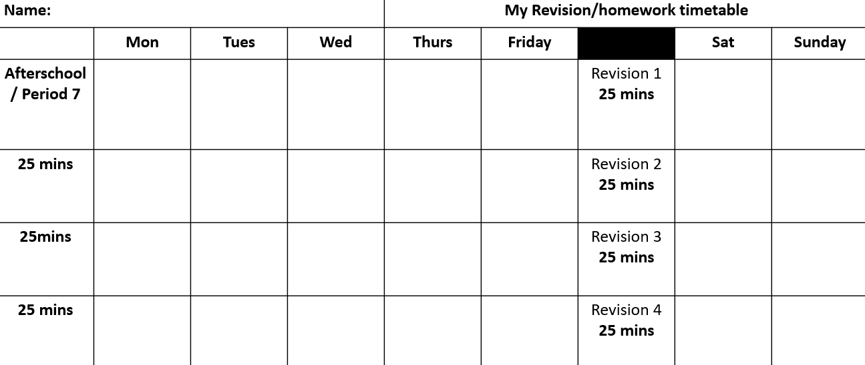
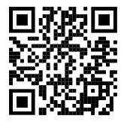
Revision Timetable
Revision timetables are a great way to make yourself accountable for the revision and homework you could be doing.
If you are in period 7 or extra intervention after school you can count this as revision and remember nearly all the homework you are being set in year 11 is revision so make sure this is part of your timetable.
Remember to take breaks! This is so important. Research says that the best ways to revise in 25 minute blocks. After each 25 minute block of revision you should take a short break such as make a drink, short walk, have a snack.
Be realistic with your revision timetable. Do you have commitments some evenings which will stop you from revising? Make sure you incorporate them into your time table.
A great video summarising revision techniques and the important of taking breaks during revision

Slide 10
The Pathway to Success in…
English Literature (AQA)
Exam Schedule – Summer 2023
Exam Title | When | Key Content
English Literature Paper 1 1 hour 45 mins | Wednesday 17th May (am) | Section A – Shakespeare (Macbeth / Romeo and Juliet) There will be an extract to analyse and then the rest of the play to comment on. You will write one essay. Section B - 19th Century Novel (Dr Jekyll & Mr Hyde / A Christmas Carol) There will be an extract to analyse and then the rest of the play to comment on.
English Literature Paper 2 2 hours 15 minutes | Wednesday 24th May (am) | Section A – An Inspector Calls. You will choose ONE of two questions to answer. You will write one essay. Section B - Conflict and Power poetry. Compare the named poem with another poem from the anthology. One essay. Section C- Unseen poetry One question on an unseen poem provided by the exam board. One question on comparing the unseen poems provided by the exam board. Students will need to answer both questions in the poetry section.
English’s Top Revision Tips
4) Practise
Practise planning and writing exam answers (practice titles will be provided by class teachers). Make sure you answer these using the structure you learn in class.
5) Responding to Feedback
Go through your class book and respond to the feedback that you received from your teacher.
Attempt exam questions again where you have not received full marks and try past papers under timed conditions.
6) Revision Guides
Consider purchasing revision guides.
1) Revisit the texts
Re-read sections of the book or play where important changes, events or developments take place.
Watch the film (but remember it’s the book that counts).
Try writing the plot of the book in just ten sentences.
Learn key quotations for each of the texts.
Complete quote flashcards for key characters and themes .
Make poster size mind-maps covering every aspect of the books
Refresh your knowledge of the social context of the text
2) Seneca
Use Seneca learning for both Literature and Language work.
3) Massolit Lectures
Use the website to watch the lectures on all the texts.
IMPORTANT
Both papers include the texts studied across the country. Students must ensure that they turn the pages and only answer the appropriate questions for the texts that they have studied. They can ask an invigilator if they are unsure.

Slide 11
The Pathway to Success in…
English Language (AQA)
Exam Schedule – Summer 2023
Exam Title | When | Key Content
English Language Paper 1 1 hr 45 mins | Monday 5th June (am) | Section A - You will be given one source from either the 20th or 21st century. Its genre will be prose fiction. There will be 4 reading questions, including analysis of language, structure and evaluation of a statement. Section B - You will be given two writing tasks which will be based on descriptive and/or narrative writing. You write one.
English Language Paper 2 1 hr 45 mins | Monday 12th June (am) | Section A – You will be given two linked sources from different time periods and genres. One will be from 19th Century and either the 20th or 21st century. There will be 4 reading questions including synthesis, analysis of language and comparison of viewpoints. Section B – You will be given one writing task which will be based on persuasive/argumentative writing, which will be linked to the theme presented in the sources.
English’s Top Revision Tips:
1) Practise
Read a range of newspaper/web news articles from 19th/20th/21st Century especially different ones about the same subject and think about how the coverage differs. Summarise the content of these articles.
Read through a website or a magazine article about a topical issue and summarise the main points and the writer’s perspective.
Practise writing a persuasive/argumentative article/letter/speech in a particular style using all the techniques you have learnt.
Practise writing descriptively using the skills you’ve learnt, focusing particularly on imagery such as metaphors and personification.
Read 19th Century non-fiction to understand the complex language.
2) Respond to Feedback
Go through your class book and respond to the feedback that you received from your teacher.
Attempt exam questions again where you have not received full marks.
Attempt past papers and practice completing these under timed conditions.
3) Revision Guides
Consider purchasing a revision guide.
4) Seneca
Use Seneca learning to help with both Literature and Language.
5) Terminology
Create flashcards to learn both descriptive and rhetorical techniques.

Slide 12
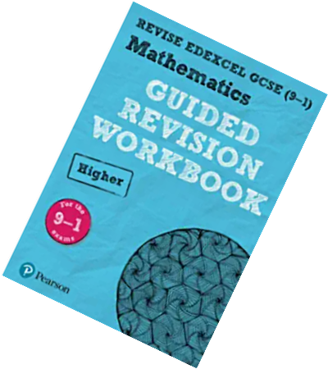
The Pathway to Success in…
Mathematics
Exam Schedule – Summer 2023
Exam Title | When | Key Content
Maths – Paper 1 Non-Calculator | Friday 19th May | All papers include all areas of maths
Maths – Paper 2 Calculator | Wednesday 7th June
Maths – Paper 3 Calculator | Wednesday 14th June
Ways to revise maths:
We recommend a range of methods for revising maths.
You can look at all of them and decide which works best for you.
Use your mock feedback to help you prioritise the topics you need to cover.
Make revision active – For example, make flashcards and test yourself, answer practise questions, copy worked examples and try to recreate them without looking. Don’t just look at the revision guide or your exercise book!
Use the revision looms on the Google classroom! Watch the videos and try the worksheets.
Or use the blue Pearson workbooks that were issued to you last year. If you can’t find it, let us know.
There are matching videos and worksheets here: Mr Morley Maths - Student Zone You can search by topic or by tier, or alternatively you can download a revision workbook.
You can also print exam questions by topic from Mathsgenie Maths Genie • Learn GCSE Maths for Free and they do have useful video clips. Answers are available on the site too.
You can practise fluency, skill based questions on Corbett maths Videos and Worksheets – Corbettmaths. They also have videos and answers to help you.

Slide 13
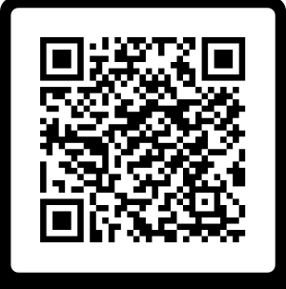
The Pathway to Success in…
Science
Exam Schedule – Summer 2023
Exam Title | When | Key Content
Biology Paper 1 | Tuesday 16 May | Cell Biology; Organisation; Infection and response; and Bioenergetics.
Biology Paper 2 | Friday 9 June | Homeostasis and response; Inheritance, variation and evolution; and Ecology.
Chemistry Paper 1 | Monday 22 May | Fundamental topics - Atomic structure and the periodic table; Bonding, structure, and the properties of matter; Quantitative chemistry; Chemical Reactions - Chemical changes; and Energy changes.
Chemistry Paper 2 | Tuesday 13 June | The rate and extent of chemical change; Organic chemistry; Chemical analysis; Chemistry of the atmosphere; and Using resources. (Plus fundamental topics)
Physics Paper 1 | Thursday 25 May | Energy; Electricity; Particle model of matter; and Atomic structure.
Physics Paper 2 | Friday 16 June | Forces; Waves; and Magnetism and electromagnetism; Space (Physics GCSE only)
Science’s Top Revision Resources
1) Use the science website.
Links to revision materials, knowledge organisers, loom videos and past papers
2) Your subject google classroom
Links to a range of revision and lesson content
3)Kerboodle
Log in for videos, podcasts, questions and practice quiziz.
4)Seneca Learning www.senecalearning.com
5) Revisely - https://www.revisely.co.uk/
Science’s Top Revision Tip - It’s never too late to start
Know the exam content -, use flash cards, mind maps, seneca and knowledge organisers for knowledge
Practice your understanding - quick progress checks - kerboodle, Quizziz
Apply your knowledge - past paper questions - don’t forget to check answer and make improvements
Science website
Ask your teachers for support -
Attend science clinic - Wednesday E6 3.30

Slide 14
The Pathway to Success in…
History & Ancient History
History Paper 1 2 hours | Thursday 18th May (AM) | Section A – Voyages of Discovery and Conquest of the Americas 1492-1522 (Aztecs) Section B – Empire, Reform and War in Britain 1890-1918
History Paper 2 2 hours | Wednesday 7th June (PM) | Section A – Medicine Through Time c.500 to the present day Section B – Development of Germany 1919-1990
Ancient History Paper 1 1 hour 45 minutes | Friday 19th May (PM) | Greece and Persia paper Section A – The Persian Empire, 559-465BC Section B – Alexander the Great 356-323BC
Ancient History Paper 2 1 hour 45 minutes | Friday 26th May (AM) | Rome and its neighbours paper Section A – Foundations of Rome, 753-440BC Section B – Cleopatra: Rome and Egypt, 69-30BC

Slide 15
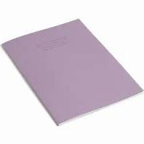
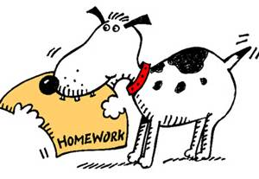

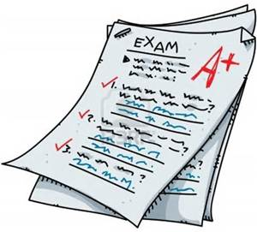

The Pathway to Success in…
History & Ancient History
History Top Revision Tips
Utilise your exercise books!
- They are incredible in terms of the detail you have. Read through your notes, highlight key points, look at exam questions and the feedback you received on them. Responding to feedback lessons give you the opportunity to go over your notes again, and we also do feedback after every assessment.
Homework
All of your homework in Year 11 is revision based. Do your homework well, and you are on the right lines!
Flash Cards
Perfect for making cards on the different key questions, key people, events and dates. Use them to test yourself. You can get these from the History department.
Practice Questions/papers
Your teachers have loads of example papers for you to use – as well as advice sheets to accompany them.
BBC Bitesize
There are some good areas of Bitesize, namely the quizzes. But please keep in mind it isn’t specific to our exam board. You can use this to check your progress and knowledge.
YouTube!
Watch documentaries about the different topics to gain a broader insight in to the topics.

Slide 16

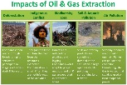


The Pathway to Success in…
Geography
Exam Schedule – Summer 2023
Exam Title | When | Key Content
Paper 1 – Living with the Physical Environment |  | Tectonic Hazards; Climate and Change; Weather Hazards; Ecosystems + Tropical Rainforests; Hot Deserts, Coastal + River Landscapes in the UK
Paper 2: Challenges in the Human Environment |  | Urban Issues and Challenges; The Changing Economic World; The Challenge of Resource Management + a focus on Water Management
Paper 3: Geographical Applications |  | Issue Evaluation; Fieldwork
Geography’s Top Revision Tips
1) Case study cards
These include key content for each topic.
Flick through a set before bedtime.
Use them with a family member as a quiz.
Try to fill out blank copies found on Google Drive.
2) BBC Bitesize
Go to the Geography section on the BBC GCSE Bitesize website.
Here you can find key features, videos and short knowledge-based tests for many of the units that we teach
3) Reacting to Feedback
Go through your class book and react to the feedback that you received from your teacher.
Attempt exam questions again where you have not received full marks.
Plan exam questions using the Point-Evidence-Connective-Explain structure.
4) Knowledge Planners
Use the knowledge planners to help with your revision. These will have all the content you need to know for the exam in them, as well as helpful hints and tips on exam technique
5) Brainscape
Here you can create online flash cards
Download the app onto your phone and revise anywhere and anytime
Most importantly if you are struggling/not sure speak to your geography teacher!

Slide 17

The Pathway to Success in…
Philosophy
Exam Schedule – Summer 2023
Exam Title | When | Key Content
Paper 1 – Christianity and Buddhism (Beliefs and Practices) | 15th May 2023 | Paper 1: Christianity and Buddhism Beliefs and Practices Paper 2: Thematic Paper Religion and Life, Crime and Punishment, Peace and Conflict & Human Rights and Social Responsibility. ●
Paper 2 – Thematic Paper | 23rd May 2023
Where can I find the content overview?
Topic Overview (PLC)
Where can I find lesson resources?
Teacher Resources
Where can I find past papers and mark schemes?
Past Papers and Mark Schemes
Revision Tips for Philosophy
1) Exam technique
-Practice past paper questions using the link above (include timing yourself).
-Focus on 12 mark structure using the following link
2) Use Google Classroom
•Login to the Google Classroom where you can find access to the teaching materials, and other useful info.
3) Create a checklist for revision
•Use the PLC link above to go through the different topics within each paper. Within your revision ensure to spend time going through key terms and definitions.
Most importantly if you are struggling/not sure speak to your geography teacher!

Slide 18


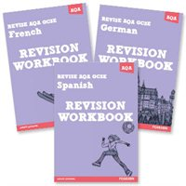
The Pathway to Success in…
French
Exam Schedule – Summer 2023
Exam Title | When | Key Content
Paper 1 – Listening | 23/5 | Theme 1 – Identity and Culture Me, my family and my friends; Technology in every day life; Free time activities; Customs and festivals Theme 2 – Local, National and International interests Home, town, neighbourhood and region; Social issues; Global issues; Travel and tourism Theme 3 – Current & future studies and employment My studies; Life at school; Education post-16; Jobs, career choices and ambitions
Paper 2 – Speaking | w/c 24/4
Paper 3 - Reading | 23/5
Paper 4 - Writing | 5/6
French’s Top Revision Tip
1) Learn your key vocabulary
Aim to learn 10 new words a day.
Spend 10 to 15 minutes in the morning revising them and get a friend or family member to test you at the end of the day.
Make a list of words you found difficult to remember and return to these regularly.
Use the Leitner system to create flashcards and test yourself on key vocabulary
Create a mind-map for each topic area or sub-topic. Do this without your book at first, then take the time to revise before adding to it.
Remember to revise how the word sounds, not just how it looks. Use an Online Audio Dictionary or create a voki on www. You voki.com.
Join the AQA French GCSE course on Memrise or have a go on quizlet.
2) Revision Guide & Workbook
Purchase the AQA GCSE revision guide and workbook to access topic by topic vocabulary lists, practice questions, mock exam papers and audio files.
3) BBC Bitesize
Go to the French section on the BBC GCSE Bitesize website.
Here you can find listening and reading activities for a variety of topics at both Higher and Foundation level.
4) ActivLearn
Complete listening, reading and grammar exercises set by your teacher on ActivLearn. Also use the library to access extra revision tasks.
5) Other Revision Websites
Seneca Learning
https://senecalearning.com/en-GB/
French Revision
http://www.frenchrevision.co.uk/
Languages Online(Grammar) http://www.languagesonline.org.uk
Finally remember that it’s impossible to ‘cram’ for a Languages exam! ‘Little and often’ is the best policy. Work out a system that suits you best.

Slide 19
The Pathway to Success in…
German
Exam Schedule – Summer 2023
Exam Title | When | Key Content
Paper 1 – Listening | 16/5 | Theme 1 – Identity and Culture Me, my family and my friends; Technology in every day life; Free time activities; Customs and festivals Theme 2 – Local, National and International interests Home, town, neighbourhood and region; Social issues; Global issues; Travel and tourism Theme 3 – Current & future studies and employment My studies; Life at school; Education post-16; Jobs, career choices and ambitions
Paper 2 – Speaking | w/c 24/4
Paper 3 - Reading | 16/5
Paper 4 - Writing | 26/5
German’s Top Revision Tip
1) Learn your key vocabulary
Aim to learn 10 new words a day.
Spend 10 to 15 minutes in the morning revising them and get a friend or family member to test you at the end of the day.
Make a list of words you found difficult to remember and return to these regularly.
Use the Leitner system to create flashcards and test yourself on key vocabulary
Create a mind-map for each topic area or sub-topic. Do this without your book at first, then take the time to revise before adding to it.
Remember to revise how the word sounds, not just how it looks. Use an Online Audio Dictionary or create a voki on www.voki.com.
Join the AQA German GCSE course on Memrise.
2) Revision Guide & Workbook
Purchase the AQA GCSE revision guide and workbook to access topic by topic vocabulary lists, practice questions, mock exam papers and audio files.
3) BBC Bitesize
Go to the German section on the BBC GCSE Bitesize website.
Here you can find listening and reading activities for a variety of topics at both Higher and Foundation level.
4) ActivLearn
Complete listening, reading and grammar exercises set by your teacher on ActivLearn. Also use the library to access extra revision tasks.
5) Other Revision Websites
Seneca Learning
https://senecalearning.com/en-GB/
German Revision
http://www.germanrevision.co.uk/
Languages Online(Grammar) http://www.languagesonline.org.uk
Finally remember that it’s impossible to ‘cram’ for a Languages exam! ‘Little and often’ is the best policy. Work out a system that suits you best.

Slide 20
The Pathway to Success in…
Spanish
Exam Schedule – Summer 2023
Exam Title | When | Key Content
Paper 1 – Listening | 6/6 | Theme 1 – Identity and Culture Me, my family and my friends; Technology in every day life; Free time activities; Customs and festivals Theme 2 – Local, National and International interests Home, town, neighbourhood and region; Social issues; Global issues; Travel and tourism Theme 3 – Current & future studies and employment My studies; Life at school; Education post-16; Jobs, career choices and ambitions
Paper 2 – Speaking | w/c 24/4
Paper 3 - Reading | 6/6
Paper 4 - Writing | 13/6
Spanish’s Top Revision Tip
1) Learn your key vocabulary
Aim to learn 10 new words a day.
Use Memrise - AQA GCSE Vocabulary to revise key vocabulary across topics.
Set a daily goal on your phone and stick to it!
Get a friend or family member to test you at the end of the day.
Make a list of words you found difficult to remember and return to these regularly.
Use the Leitner system to create flashcards and test yourself on key vocabulary
Create a mind-map for each topic area or sub-topic. Do this without your book at first, then take the time to revise before adding to it.
Remember to revise how the word sounds, not just how it looks. Use an Online Audio Dictionary or create a voki on www.voki.com.
2) Revision Guide & Workbook
Purchase the AQA GCSE revision guide and workbook to access topic by topic vocabulary lists, practice questions, mock exam papers and audio files.
3) BBC Bitesize
Go to the Spanish section on the BBC GCSE Bitesize website.
Here you can find listening and reading activities for a variety of topics at both Higher and Foundation level.
4) ActivLearn
Complete listening, reading and grammar exercises set by your teacher on ActivLearn. Also use the library to access extra revision tasks.
5) Other Revision Websites
Seneca Learning
https://senecalearning.com/en-GB/
Spanish Revision
http://www.spanishrevision.co.uk/
Languages Online(Grammar) http://www.languagesonline.org.uk
Finally remember that it’s impossible to ‘cram’ for a Languages exam! ‘Little and often’ is the best policy. Work out a system that suits you best.

Slide 21

The Pathway to Success in…
Sociology
Exam Schedule – Summer 2023
Exam Title | When | Key Content
AQA Paper 1 – Family and Education |  | Research Methods Sociological theories relating to the Family Sociological theories relating to Education
AQA Paper 2 – Crime and Deviance, Social Stratification |  | Research methods Sociological theories linking to crime Sociological theories relating to social stratification
3) Watch YouTube videos
Go onto ‘Sociology guy’ and click on uploads to access all the topics. Stretch yourself with A level content
Watch alongside your notes or revision cards – add/check.
Do the practice questions that are set on the videos.
4) Reacting to Feedback
Go through your class book and react to the feedback that you received from your teacher.
Attempt exam questions again where you have not received full marks.
Plan exam questions using the Point-Evidence-Explain-Evaluate structure.
5) Use Seneca
Log onto Seneca or download the app.
Access all the revision materials set by your teacher.
Practice exam technique
6) Use the exam workbook
Make use of the exam workbook given to you by your teacher.
Make sure they are completed in enough detail
Have your exam questions marked and ask for feedback on how to improve!
Sociology Top Revision Tips
1) Page, paragraph, post-it
Read a page in your book
Re-read using a highlighter for what is important and what you need further help on
Add any other linked examples/theories / research methods (from other units)
Summarize into 1 paragraph or an index card
Further reduce key points onto a post-it note (only key words/ideas to trigger what you know.
1 unit should go on 1 A4 sheet – stick in a place you will see often.
Use them with a family member as a quiz.
2) Use TPSSmart
Log on to your sociology class Google Classroom
Access Revision PowerPoints and Handouts for every topic.
Download Past Exam Papers and their Mark Schemes to develop your exam technique.

Slide 22
The Pathway to Success in…
Economics
Exam Schedule – Summer 2023
Exam Title | When | Key Content
Paper 1 – Introduction to Economics and the role of markets |  | Microeconomics – economic behavior within individual markets, consumers/producers and employers/employees. Introduction to basic concepts of economics The role of markets and money and how we analyze them.
Paper 2: The objectives and role of Government and International trade and Globalisation |  | Macroeconomics – Explain how the economy as a whole works Economic objectives and the role of government International trade and the global economy
Revision Tips for Economics
1) Exam technique
Have a strategy for MCQs.
Understand the command words
Know exactly how to structure and phrase Analysis and Evaluate questions.
2) Use Google Classroom
Login to the Google Classroom where you can find access to the teaching materials, and other useful info.
Find a place to discuss or read annotations of the work.
3) Learn the key terms
These are on the knowledge organisers and have been given out to you separately as a list
4) Homework
Complete the questions given out in class and mark these using the answers on classroom
5) Reacting to Feedback
Go through your previous exams, improve answers that you have done before.
Look at class assessments and work on the areas you fell short
Create new exam questions in the same style and format and practice the exam techniques
6) Revision Workbook
Consider purchasing a revision workbook to go alongside your revision guide.
7) Knowledge Organisers
Use the knowledge organiser to help with your revision. These will have all the content you need to know for the exam in them, as well as helpful hints and tips on exam technique.
8) Do the past papers
I have given out lots of past papers for you to work on
Remember your best resource is each other and if you are unsure speak to your Economics teacher

Slide 23
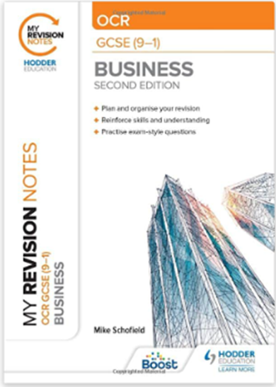
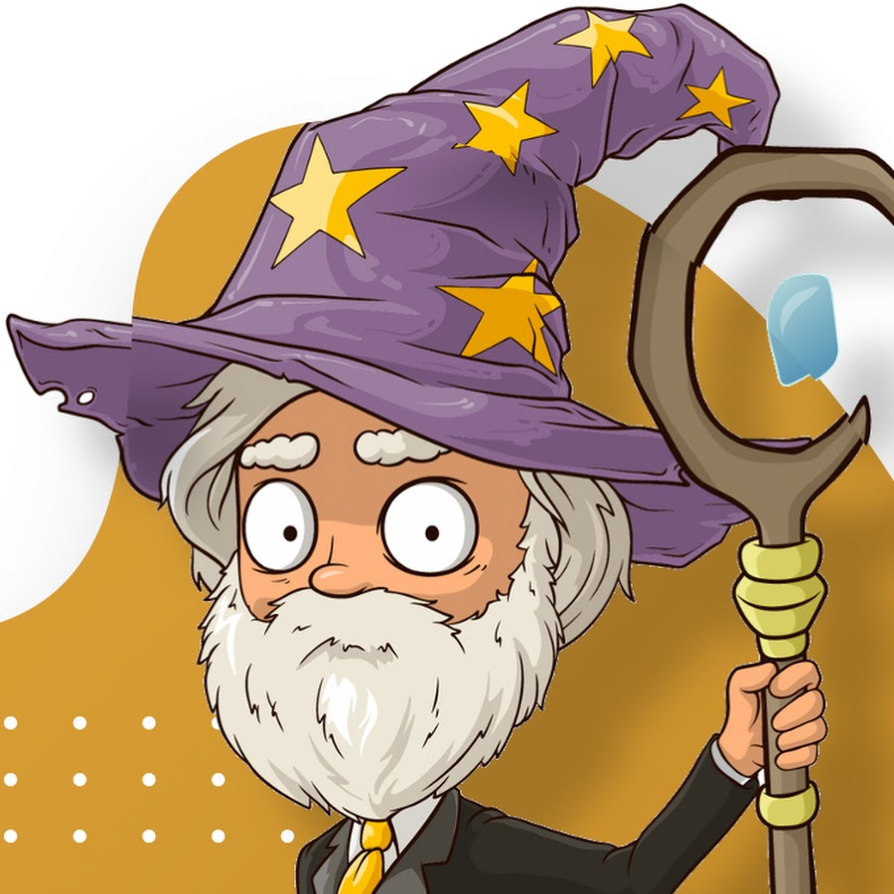
The Pathway to Success in…
Business Studies (OCR)
Exam Schedule – Summer 2023
Exam Title | When | Key Content
Unit 1 – Business Activity, Marketing and People | Thursday 18th May PM | This question paper consists of 4 sections. Section 1 is 15 multiple choice questions covering topics within Business Activity, Marketing and People. Sections 2-4 consist of a range of long and short answer questions based on a business scenario.
Unit 2: Finance, Operations and the External Environment | Monday 12th June PM | This question paper consists of 4 sections. Section 1 is 15 multiple choice questions covering topics within Operations, Finance and the External Environment. Sections 2-4 consist of a range of long and short answer questions based on a business scenario.
Business Studies Top Revision Tips
1) Start by focusing on the theory you’re unsure of, to identify this:
Use the RAG tick sheets given by your teacher
Go through the OCR specification with a highlighter
2) Revise the knowledge
Create flashcards or revision posters on the topics you need to recap.
See Google Classroom for topic slides
Use your revision guide to help with these (see below right - can be purchased from Amazon or any other bookseller)
Go to the Business Studies section on the BBC GCSE Bitesize website.
Subscribe to Bisconsesh https://bit.ly/3jbfBKy
Subscribe to BizzWizard https://bit.ly/336Tsrg
3) Do ‘low-stakes’ quizzes to test your knowledge:
Log into Seneca www.senecalearning.com
Log into Quizlet (links on Google Classroom for all 6 units across the 2 papers)
4) Now focus on past papers
All of the past papers, mark schemes and examiner reports have been shared with you on Google Classroom
Attempt exam questions again where you have not received full marks using your previous mocks and end of topic tests.
If you want a physical copy of a paper, we have loads in the back of i1! Pink ones are paper 1, yellow are paper 2.

Slide 24

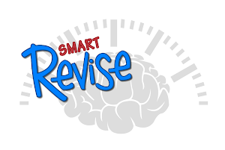
The Pathway to Success in…
Computer Science
Exam Schedule – Summer 2023
Exam Title | When | Key Content
J277/01 – Computer Systems | Friday 19 May PM | A series of multiple choice, short answer, long answer and problem solving questions on Systems Architecture, Memory and Storage, Computer Networks, connections and protocols, Network Security, System Software & Ethical, Legal, Cultural and Environmental impacts of digital technology.
J277/02 – Computational thinking, algorithms and programming | Thursday 25 May PM | A series of multiple choice, short answer, long answer and problem solving questions on Algorithms, Programming fundamentals, Producing robust programs, Boolean logic, Programming languages and Integrated Development Environments.
Computing’s Top Revision Tips
1) Make revision cards or posters to use at
home.
Stick posters on the backs of doors, in the kitchen and around your room.
Ask your parents / siblings to test you using the revision cards.
Use www.brainscape.com to create Flash cards and get a buddy to test you
2) Use Smart Revise
Log on to smart revise: https://smartrevise.online/ to access your funded Computer Science revision portal
3) Helpful Websites
Go to the Computer Science section on the BBC GCSE Bitesize website. Use the online tests to check understanding.
Use Craig n Dave’s YouTube Channel and revise the topics in the Computing section. They have videos for topics across the whole J277 specification
Use www.thestudentroom.co.uk resources and a forum to ask and answer questions
4) Past Papers
All of the past papers, mark schemes are in the Google Classroom and on the OCR website. You can also find printed copies at the back of J14
Attempt exam questions again where you have not received full marks (DIRT)
5) Revision Guides / Workbook
Consider purchasing a revision guide, revision workbook and flashcards from CGP
You already have access to additional revision materials on Google Classroom, including a full glossary of terms for both papers
Use the printed specification checklist you were given in November. This will tell you what you need to know for both appears and it was highlighted to indicate what areas needed improving after November Mocks.
6)

Slide 25
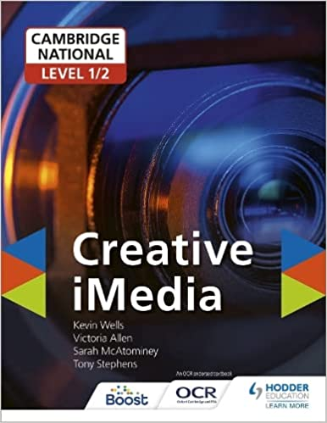
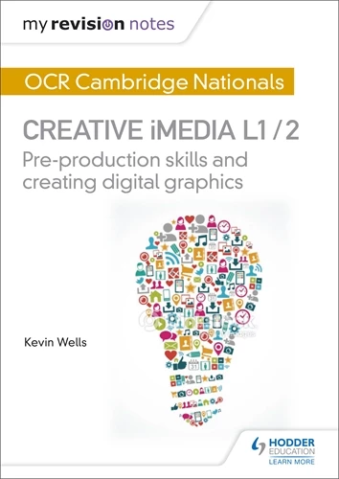
The Pathway to Success in…
Creative iMedia
Exam Schedule – Summer 2023
Exam Title | When | Key Content
J817/ R081 – Pre-production Skills | Monday 12 June PM | A series of multiple choice, short answer, long answer and creative design questions on the purpose and content of pre-production, planning, producing and reviewing pre-production.
*Please note, most students have already sat this examination. This is only relevant for those students completing exam resits.
iMedia’s Top Revision Tips
1) Make revision cards or posters to use at
home.
Stick posters on the backs of doors, in the kitchen and around your room.
Ask your parents / siblings to test you using the revision cards.
Use www.brainscape.com to create Flash cards and get a buddy to test you
Use the premade Google Slides ‘flashcards’ which are posted on Google Classroom
2) Use Knowledge Organisers
Log on to Google Classroom to access knowledge organisers for the whole exam
3) Helpful Websites
Go to the R081 section on the https://studyimedia.co.uk/ website. Use the online tests to check understanding.
Use www.thestudentroom.co.uk resources and a forum to ask and answer questions
Go to the R081 section on the http://www.bluesquarething.co.uk/ website. Use the online quizzes and exam questions to check understanding.
4) Past Papers
All of the past papers, mark schemes are in the Google Classroom and on the OCR website. You can also find printed copies at the back of J14 and i1
Attempt exam questions again where you have not received full marks (DIRT)
5) Revision Guides / Workbook
Consider purchasing a revision guide, revision workbook and flashcards from CGP
You already have access to additional revision materials on Google Classroom

Slide 26
The Pathway to Success in…
Physical Education
Exam Schedule – Summer 2023
Exam Title | When | Key Content
Paper 1: The human body and movement in physical activity and sport |  | Written exam: 1 hour 15 minutes – 30% of GCSE Answer all questions! A mixture of multiple choice/objective test questions, short answer questions and extended answer questions based on:- Applied anatomy and physiology Movement analysis Physical training Use of data
Paper 2: Socio-cultural influences and well-being in physical activity and sport |  | Written exam: 1 hour 15 minutes – 30% of GCSE Answer all questions! A mixture of multiple choice/objective test questions, short answer questions and extended answer questions based on:- Sports psychology Socio-cultural influences Health, fitness and well-being Use of data
Non-exam assessment: Practical performance in physical activity and sport |  | Practical performance in three different physical activities in the role of player/performer (one in a team activity, one in an individual activity and a third in either a team or in an individual activity). Analysis and evaluation of performance to bring about improvement in one activity.
Revision Tips for Physical Education
1) Exam technique rainbows
Understand the command words
Know exactly how to structure and phrase Analysis, Evaluate and Justify questions.
2) Use OneDrive and Teams
Log on to the TPS Portal or Teams to access the revision tools that have been shared with you all
Access a Lesson PowerPoints for every topic, which includes all key content.
4) Past Papers
All of the past papers, mark schemes are in the Google Classroom and on the AQA website
Attempt exam questions again where you have not received full marks (DIRT)
4) Homework
Do Seneca practice
Revisit past topic using the homework knowledge planners
5) Make revision cards or posters to use at
home.
Stick posters on the backs of doors, in the kitchen and around your room.
Ask your parents / siblings to test you using the revision cards.
Use www.brainscape.com to create Flash cards and get a buddy to test you
6) Reacting to Feedback
Go through your previous exams, improve answers that you have done before.
Look at class assessments and work on the areas you fell short
Create new exam questions in the same style and format and practice the exam techniques
7) Revision Guides / Pack
Consider purchasing a revision guide or workbook. Revision guides are available directly from the PE office

Slide 27

The Pathway to Success in…
Food Preparation and Nutrition
Exam Schedule – Summer 2023
Exam Title | When | Key Content
NEA 1 Food Investigation Assessment | Assessed by teacher. Submitted 5th May. | 15% of GCSE [30 marks] A scientific food investigation which will assess the learner's knowledge, skills and understanding in relation to scientific principles underlying the preparation and cooking of food. 8 hours
NEA 2 Food preparation assessment | Assessed by teacher. Submitted 5th May. | 35% of GCSE [70 marks] Prepare, cook and present a menu which assesses the learner’s knowledge, skills and understanding in relation to the planning, preparation, cooking and presentation of food. 12 hours including a 3 hour practical examination
Written examination | 20th June 23 | 50% of GCSE [100 marks]
Food Preparation and Nutrition Top Revision Tips
1) Key knowledge:
Nutrients - their functions, sources, deficiencies, and excess.
Commodities - what are they, what benefits do they provide, processing, uses etc. (cereals, fruit and vegetables, meat, fish, poultry, eggs, alternative proteins, sugars, syrups, sweeteners, milk, cheese, yoghurt, cream)
Factors affecting food choice - what affects choices? How can you ensure they eat a healthy balanced diet? How can you modify recipes to meet a requirement?
Scientific Processes - any process involved in the cooking and making of food.
2) Exam questions
Use the Eduqas website to access past exam question papers.
Use the exemplar answers on Eduqas to mark your work.
Use different coloured pens to mark your work and add additional information.
3) BBC Bitesize
Go to the Food and Science section on the BBC GCSE Bitesize website.
Here you can find key features, videos and short knowledge-based tests for topics covered.
4) Revision Schedule
Follow the revision schedule set by your teacher
5) Reacting to Feedback
Go through your class book and react to the feedback that you received from your teacher.
Attempt exam questions again where you have not received full marks.
Plan exam questions using the Point-Evidence-Connective-Explain structure.
6) Use the revision materials printed and shared with you. Complete independent revision using the materials available to you.
7) Seneca - Use seneca to revise topics you are not confident in. We are with the EDUQAS exam board.
7) In the exam
Read the question.
Reread the question.
Highlight key words.
Look to see how many marks the question is worth and plan your time.
Allow yourself time to think and structure your answer.
Read and reread your answer.
Check spellings
27

Slide 28

The Pathway to Success in…
Design + Technology
Exam Schedule – Summer 2023
Exam Title | When | Key Content
NEA | 21st April 23 | 50% of final GCSE grade
Written paper | June 19th 23 | 2 hour written exam paper 50% of final GCSE grade
Design and Technology’s Top Revision Tips
1) Exam questions
Use the Eduqas website to access information resources (link below).
Use the Google Classroom to access past exam questions for units of work covered
Use different coloured pens to mark your work and add additional information.
2) Websites
GCSE bitesize
https://resource.download.wjec.co.uk/vtc/2016-17/16-17_1-4/website/index.html
www.technologystudent.com/
http://www.design-technology.info/
3) Reacting to Feedback
Go through your class book and react to the feedback that you received from your teacher.
Attempt exam questions again where you have not received full marks.
Plan exam questions using the Point-Evidence-Connective-Explain structure.
4) Units of work ( core knowledge and in depth knowledge)
Follow the revision schedule set by your teacher.
Read through all of your core knowledge information in your books.
Use the DT knowledge planners
Make a set of detailed revision cards for each of the core knowledge headings.
Produce revision cards for In depth knowledge areas ( TIMBERS and POLYMERS)
Use information resources on the Google Classroom and recorded looms.
5) Look at products around you and analyse
What materials are they made of?
How are they made?
Who have they been designed for?
How could they be improved.
What is the environmental impact of the product?
6) In the exam
Read the questions in the exam paper.
Reread the question.
Highlight key words.
Look to see how many marks the question is worth and plan your time.
Allow yourself time to think and structure your answer.
Read and reread your answer.

Slide 29
The Pathway to Success in…
Music
Exam Schedule – Summer 2023
Exam Title | When | Key Content
Component 1: Performing Music | Friday 21st April final deadline | 1 solo performance 1 ensemble performance (minimum 1 min) Minimum time for both 4 mins Each performance requires a recording and score
Component 2: Composing Music | Friday 21st April final deadline | 1 composition to a brief given by Eduqas 1 free composition Combined length 3-6 mins. A piece requires audio, score/commentary, and written composition logbook
Component 3: Appraising Music | Wednesday 14th June 2023 | 75 min listening exam paper 8 listening extracts, each with questions worth 12 marks Each extract links to one of the four Areas of study 2 of the questions are on the prepared extracts
Music’s Top Revision Tips
Revise these areas in the following ways:
Elements (MAD T-SHIRT)
Areas of Study 1-4
Music Theory
Prepared Extracts
1) Knowledge Organisers
These include key terminology for each of the 4 Area of Study and for the Study Pieces.
Read through a section at a time and memorise key terms for each topic
Get a friend/family to quiz you
Test each other in class and listen to examples of key features
2) Drill Aural and Score-Reading Skills
Use exercises direct from www.musictheory.net or
Re-do the exercises on Google Classroom
3) Use Google Classroom Resources
Log on to the Google classroom to access a Google Drive Revision Folder for Students covering every topic and the elements of music
4) Focus on Sound
Students log in via Google Classroom.
Lessons on every aspect of music theory, listening skills, GCSE topics etc.
Short knowledge-based tests for many of the units including all of the AOS, Prepared extracts and General music theory.
5) Responding to Feedback
Go through your mock papers (uploaded to GC) and respond to feedback that you received from your teacher.
Use the personalised feedback grid to make sure you spend time on your weaker areas (see GC).
6) Revision Guides / Listening Tests
The WJEC/ EDUQAS GCSE Music Revision guide includes all key content for the exam, as well as practice exam questions and example answers.

Slide 30
The Pathway to Success in…
Music Technology
Both exams have already been completed for Music Tech but there is one opportunity to retake both exams to improve your grade
Exam Title | When | Key Content
Practical Exam - 2 Hours | Exam window: 12-16th June* | Explaining a DAW and its associated hardware Demonstrate skills on a DAW in problem solving, creative tasks, and completing a finished mix
Written Exam - 2 Hours | Exam window: 12-16th June* | Questions on any aspect of the four units covered throughout the course Includes a listening section
Unit 1-4 NEA (Coursework) | 1st June | Unit 1 - Using a DAW Unit 2 - Creating Music Unit 3 - Recording Sound Unit 4 - Sound Creation
Music Techs Top Revision Tips
Google classroom resources:
Student handbooks for each unit detailing each task and what needs to be handed in
Assignment hand-ins
All of the resources from each unit we have used in lessons
One stop shop - ‘How to Revise for Music Tech’ google slide presentation with hyperlinks to all the key resources including revision guide, past papers and markschemes, analysis of past papers, and much more
* Only for students retaking exams from March 2023

Slide 31
The Pathway to Success in…
Dance
Exam Schedule – Summer 2023
Exam Title | When | Key Content
Component 1 – Performance and Choreography | Friday 28th April final deadline | PERFORMANCE solo performance – 2 set phrases (approx. 1 min long). Duet/trio performance – using remaining set phrases (max of 5 mins long). CHOREOGRAPHY - Wednesday 29 March Solo or group choreography a solo (2-2.5 mins) group dance (3-3.5 mins) using 2-5 dancers
Component 2 – Dance Appreciation | 20 June 2023 | Written paper worth 40%. Exam is 1hr 30 mins You will be tested on 3 topics: Choreographic processes and performance skills. Critical appreciation of your own work. Critical appreciation of professional works.
Dance Top Revision Tips for practical Component 1:
Ensure that you plan your rehearsal time well and attend your planned extra sessions after school and at lunch.
Keep working on performance skills at home focusing on stamina and flexibility as well as all other key performance skills.
Understanding how to achieve high quality performance:
- commitment to rehearsal
- identification of the technical and expressive skills necessary for effective performance
- analysis of strengths and weaknesses of their own and others' performance and capacity to improve
- systematic repetition to enhance performance
using ICT (for example, digital camera and video) to monitor and evaluate performance.
Revise all of the following:
Physical skills and attributes
Technical skills
Expressive skills
Mental skills and attributes
Safe working practices
Mental skills and attributes
Safe working practices
The Anthology:
You must study all six works in their entirety and be prepared to describe, analyse, interpret, evaluate and reflect on the works in response to short answer and extended writing questions.
You must know the:
Features of production; costume, set, lighting, aural setting, camera, etc…
Performance environments
Choreographic approaches
Choreographic content
Choreographic intent
Artificial Things | Stopgap Dance Company | Lucy Bennett
A Linha Curva | Rambert Dance Company | Itzik Galili
Infra | The Royal Ballet | Wayne McGregor
Shadows | Phoenix Dance Theatre | Christopher Bruce
Within Her Eyes | James Cousins Company | James Cousins
Emancipation of Expressionism | Boy Blue Entertainment | Kenrick H2O Sandy

Slide 32
The Pathway to Success in…
Drama
Exam Schedule – Summer 2023
Exam Title | When | Key Content
Component 2 Devising Drama | Friday 16th Dec (practical exam) Tuesday 21st Feb (Devising Logs final hand in) | What’s assessed? Process of creating devised drama. Performance of devised drama. Analysis and evaluation of own work.
Component 3 Texts in Practice | Tuesday 28th March (practical exam date) | What’s assessed? Performance of two extracts from one play Play must contrast with the set play chosen for Component 1.
Component 1 Understanding Drama | 15 May 2023 | What’s assessed? Knowledge and understanding of Drama and Theatre. Study of one set play - Blood Brothers Analysis and evaluation of the work of live theatre makers.
Drama Top Revision Tips:
Component 2 – Devising:
Ensure that you have researched beyond your stimulus and can write about your inspiration, aims and intentions for the piece initially, in development and in analysis and evaluation.
Create a collaborative rehearsal schedule and stick to it.
Challenge yourself creatively to use new techniques - watch examples from past years.
Keep up to date with all devising log hand in dates, so you can effectively utilise support.
Component 3 – Text in Practice:
Read and Research the entire play, then learn your lines.
Utilise a rehearsal schedule outside of lessons, respond to teacher feedback and think cohesively about your creative intentions for character, set and costume/props.
Component 1 – Understanding Drama:
Beyond re-reading/watching/revising Blood Brothers and your live theatre choice, you need to:
Utilise all Component 1 Knowledge Organisers, including the revision checklist KO. This is where you can tick off tasks completed and avoid doing the same revision tasks on repeat.
Utilise further resources on Google Classroom, including:
Google Slide Presentations detailing structures for how to answer questions and top tips.
Use your ‘What Next Revision Steps’ and targets from each mock (uploaded to GC alongside your full papers) and all written feedback on mocks to develop & complete practise questions.

Slide 33
The Pathway to Success in…
Art & Design
Exam Schedule – Summer 2023
Coursework
Title | When | Key Content
Portfolio of Work 60% | DONE | One sustained project (Structures or Portrait/identity) One smaller group of work or a 2nd project (Structures or Portrait)
Externally set task 40 % | Jan - April | One sustained project responding to a starting point given by the exam board. Same expectation as for previous projects - Artists analysis, work in response to artwork studied, thorough development of an idea - reworking, experimenting, refining, producing sustained outcomes - culminating in work produced in 10 hour controlled ‘exam’ conditions.
Although not a subject requiring revision, courses in visual arts must still be correctly prepared for in order to achieve the best possible outcomes.
The Assessment Objectives require students to show:
In depth developmental practical work should evidence considered influence of artists work and other contextual references. These should be thoroughly explored in your own way and demonstrate their impact upon your own ideas.
A variety of practical studies should show experimentation and exploration of techniques and media that refine as they progress.
Observations and ideas that demonstrate understanding of the theme and contextual influences. These should be in the form of own photographs, observational practical studies and written thoughts.
Practical personal responses will conclude ideas and demonstrate meaningful links and interpretations of themes.
Most importantly refer to checklist island teacher feedback

Slide 34
The Pathway to Success in…
Art Textiles
Exam Schedule – Summer 2023
Coursework
Title | When | Key Content
Portfolio of Work 60% | DONE | One sustained project One smaller group of work or a 2nd project
Externally set task 40 % | Jan - April | One sustained project responding to a starting point given by the exam board. Same expectation as for previous projects - Artists analysis, work in response to artwork studied, thorough development of an idea - reworking, experimenting, refining, producing sustained outcomes - culminating in work produced in 10 hour controlled ‘exam’ conditions.
Although not a subject requiring revision, courses in visual arts must still be correctly prepared for in order to achieve the best possible outcomes.
The Assessment Objectives require students to show:
In depth developmental practical work should evidence considered influence of artists work and other contextual references. These should be thoroughly explored in your own way and demonstrate their impact upon your own ideas.
A variety of practical studies should show experimentation and exploration of techniques and media that refine as they progress.
Observations and ideas that demonstrate understanding of the theme and contextual influences. These should be in the form of own photographs, observational practical studies and written thoughts.
Practical personal responses will conclude ideas and demonstrate meaningful links and interpretations of themes.
Most importantly refer to checklist island teacher feed back

Slide 35
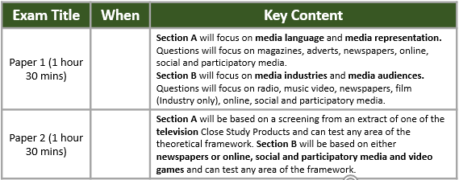
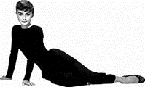


The Pathway to Success in…
Media Studies
Exam Schedule – Summer 2023
MEDIA STUDIES REVISION TOP TIPS
Be familiar with the CSPs
Rewatch the TV, music video and Film CSPs; read the newspapers and magazines and go over your CSP booklet.
Know the framework
Use the revision resources on our Google Classrooms to RAG yourself
Improve your exam technique
Use the practice questions and past papers to run through your timings and stamina.
Use Seneca to plug any gaps in your knowledge
Youtube and other Media
Watch Mrs Fisher’s videos and media-studies.com to revise. Look at websites for your CSPs, including social media, fan websites, YouTube, etc
Other tips:
Revise together
Develop revision pack for each CSP
Practice long answer questions
Practice the Unseen (access a WIDE range of media texts)

Slide 36
The Pathway to Success in…
Photography
Exam Schedule – Summer 2023
Coursework
Title | When | Key Content
Portfolio of Work 60% | on going - Deadline 20 May | One extensive project including guidance points on Google Classroom - Portrait Project One smaller group of work or a 2nd project on a theme including the same guidance. - London Project
Externally set task 40% | Option A -21 & 24 April Option B - 25 & 26 April Option C - 27 7 28 April | One sustained project responding to a starting point given by the exam board. Using the Checklist on Google Classroom. Culminating in work produced in 10 hour controlled ‘exam’ conditions.
Although not a subject requiring revision, courses in visual arts must still be correctly prepared for in order to achieve the best possible outcomes.
The Assessment Objectives require students to:
Thorough developmental photoshoots and editing should evidence considered influence of photographers work and other contextual references. These should be thoroughly explored in your own way and demonstrate their impact upon your own ideas.
A variety of ideas should show experimentation and exploration of techniques and media both digital and manual that refine as they progress.
Observations and ideas that demonstrate understanding of the theme and contextual influences. These should be in the form of own photographs, written thoughts and some drawing.
Practical personal responses will conclude ideas and demonstrate meaningful links and interpretations of themes.
Most importantly refer to checklist on Google Classroom.

Slide 37
The Pathway to Success in…
Psychology
Exam Schedule – Summer 2023
Exam Title | When | Key Content
Paper 1 | 18th May 2023 | · Criminal Psychology · Developmental Psychology · Psychological Problems · Research methods
Paper 2 | 26th May 2023 | · Social influence · Memory · Sleep and Dreaming · Research methods
Use memorisation techniques to learn the details of key studies. Remember the mnemonic 'A huge dog stole my exam paper, flipping crafty canine' and make sure you know each element for each study
Pay as much attention to criticisms of each theory and study as you do to the outline. Learn at least two for each and think about how to write PEE paragraphs.
Don't forget about the key concepts and applications of each unit - the beginning and end of the chapters are as important as the middle!
Do as many research methods practice questions as you can - and make sure you use the mark schemes to check your answers
Go over key terminology so that you can use academic language in your answers
Make the most of all the resources on google classroom and the BET Psychology website - including knowledge organisers and quizzes

