Slide 1






















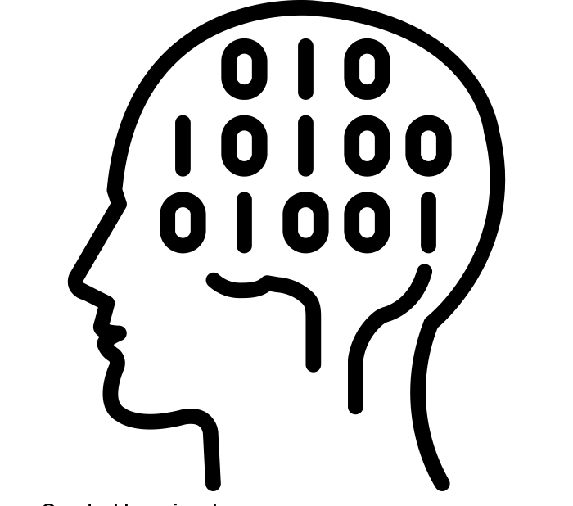




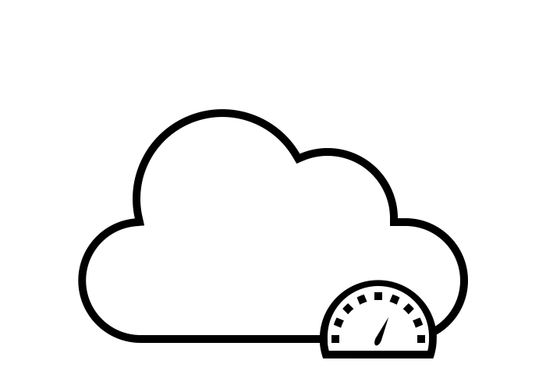

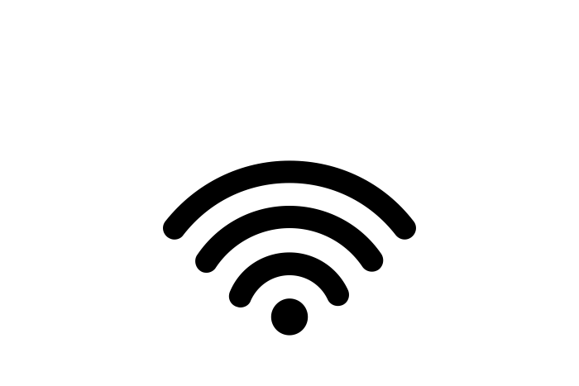




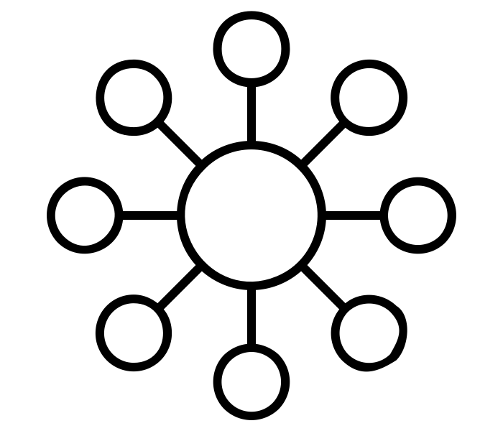

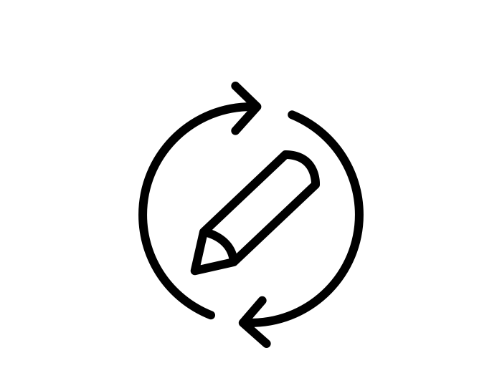

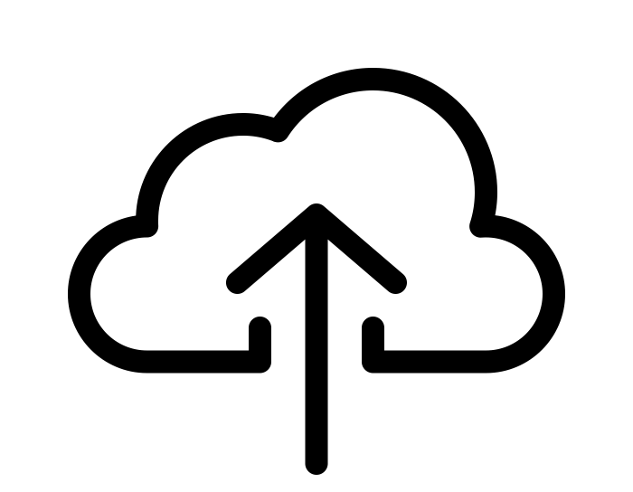
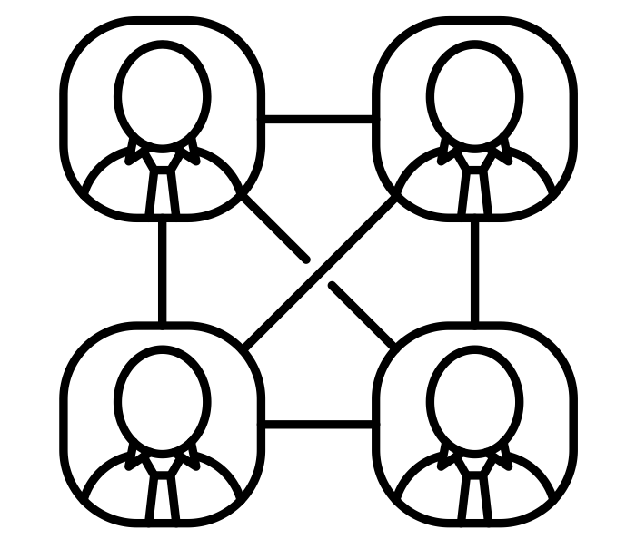


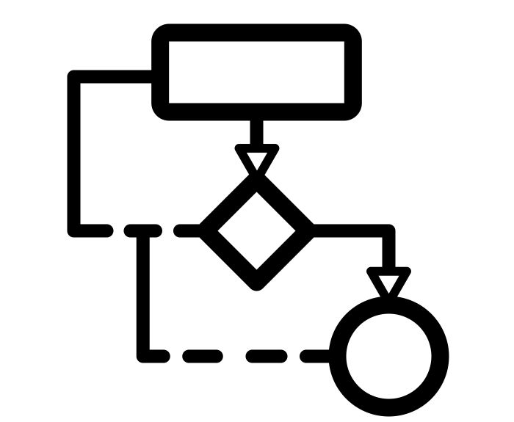

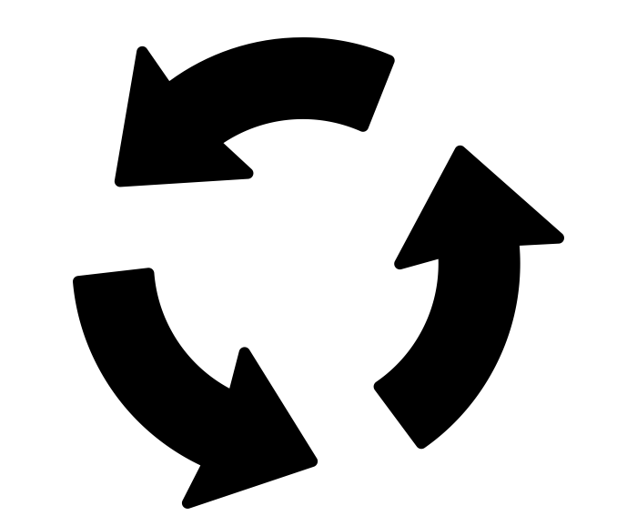


















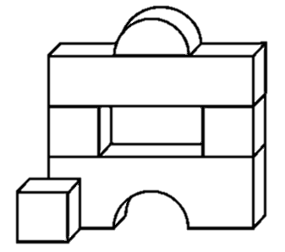














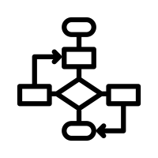


















The Five Year Curriculum: Computing
Programming & Robust Programs
Boolean Logic
Ethical & Legal Issues
Computational Thinking
System
Security
Algorithms & Computational Thinking
Data Representation
System Software
Computer Systems
Networks
Cultural & Privacy Issues
Environmental & Ethical Issues
Embedded Systems
Von Neumann architecture
System Architecture
Year
11
Ethical & Legal Issues
Systems Software
& Hardware
Integrated Development Environment
Stakeholders
Legislation
Utility Software
Operating Systems
Defensive Design
Programming & Robust Programs
SQL
Data Representation
Logic Gates
Wi-Fi vs Ethernet
Security
Arrays & Procedures
Types of Networks
Computational Thinking & Logic
Year
10
Networks
File Handling
Network Performance
Network Hardware
Networks
Search & Sort Algorithms
Computational Thinking
Packet Switching
Protocols
Network Topologies
Text-based Programming
Sequence, Selection & Iteration
Memory
Secondary Storage & The Cloud
Computer Roles in Networks
Algorithms & Programming
System
Architecture
Year
9
Design &
Create
Literacy
Producing & interpreting
algorithms
Data Types
CPU Cycle
CPU Performance
Digital Creativity
Target Audience
Digital Literacy
Programming
Text-based programming
Computational Thinking
Layout
Computer Hardware
Digital Careers
Programming
Storyboarding
Input & Output Devices
Problem
Solving
Computing Fundamentals
Computational Thinking
Digital Creativity
Problem
Solving
Debugging & Tinkering
Workings of the CPU
Layering
Image Quality
Sequence, Selection & Iteration
Data Types
& Casting
Binary Conversion
Digital Creativity
Programming
Year
8
Reflect
Hue, Lightness, Contrast, Saturation
Text-based programming
Variables & Constants
Create
Design & Create
Digital Creativity
Planning
& Research
Variables & Constants
Block-based
programming
Modelling real-world - spreadsheets
Grid references
Scale
Flowcharts
Programming
Spreadsheets
Design
Decomposition
Algorithms
Sequence, Selection
& Iteration
Tinkering & Debugging
Formatting
Formulas & Functions
Computational
Thinking
Abstraction
Online Safety &
Social Media
Staying safe
on-line
Email - etiquette, attachments
Creating & Saving to Folders
Pattern Recognition
Responsible Use of Tech
Digital Literacy
Year
7
Copyright Laws & implications
Viruses
School systems - Google Classroom
Log on;
Password Strength
How plants and animals
adapt to extreme climate

