Slide 1









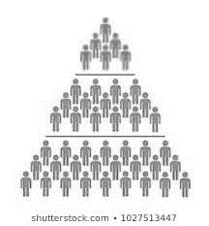
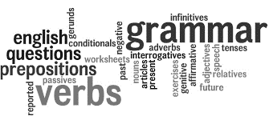

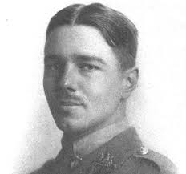






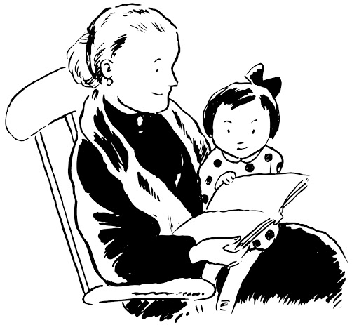

The Five Year curriculum: English
Timed practice:
All Papers
Timed practice : Lit P1
Key terms/ techniques for both questions
Revision
A-Level
Mocks 2
Timed practice Lang P1
Timed Practice Lang P2
Timed Practice with teacher models and feedback : Lang Papers
Decoding questions: skills
Analysis : key terms and phrases
AO1 and AO2
Lit Paper 2 texts : AIC revision; poetry essays and unseen poetry responses – models in class
Lit Paper 2: revise themes; plot and characters of AIC; poetry unseen
FOCUS: Language Papers
NEA tasks: group discussions
Decoding and actively reading texts in language: how to access/ how to add to perceptive points
Lang 2 comparatives and defining thoughts/ feelings key words and phrases for Lang 2 Q2 and Q4
MOCKS 1
Unseen contemporary poetry : how to access/ how to answer
Lit Paper 2 texts: poetry revision ; mind maps and models
Intertextuality
Wider reading for challenge – critical wider reading
Lit AO1, 2 and 3 for Lit 1
Voice and tonal shift;
Stagecraft; significance of extracts
Shakespeare and poetry
Year
11
Revision Lang and Lit 1
LANG P1
Revision
NEA task: presentation on A03
Mind Maps themes
Lit Paper 1 tests: themes; plot; characters. How to answer Qs; key phrases and points to include for clarity and development
Decoding skills
Construction of meaning
Unseen Non-fiction texts from 1800 - today
Unseen Fiction texts
Macbeth
Summary skills
An Inspector Calls
To what extent do you agree…?
Contemporary relevance
Shakespeare and poetry
Poetry and Lang 2
The great chain of being
Elizabethan and Jacobean belief systems
Romeo and Juliet
Crafting non fiction writing
Comparison and tracking of opposing arguments
19th C Novel
Social, historical and cultural context of studied text
Techniques of plot and pace to engage, manipulate and further impact drama
Following an argument and constructing your own
Analysing effects of linguistic devices
Analysing structural choices
What themes does Shakespeare explore and how are they relevant today?
Shakespeare text chosen by teacher
Language coinage and creativity
How do I detect a writer’s viewpoint and how can I replicate it?
Facts/statistics/opinion as fact
Jekyll and Hyde
AIC GCSE text
Lang Paper 1 skills
Year
10
Crafting narrative writing
Mastery of sentences and paragraphs
Plot and character
How tragedy and comedy are elements of human nature
What themes are being explored and how are they relevant today?
I have a dream…
Discourse markers
A Christmas Carol
Language change and use of verse/ prose
Literary influences
Colons and semi-colons
Media manipulation
Why are we so fascinated by crime?
S/L: role play; discussion/presentation based on different views in texts
Plot, theme, character
Youth language
Victorian attitudes to poverty and crime
Dramatic techniques including iambic pentameter/ prose
Shakespeare
Year
9
Genre
Exploration of other versions of society
S/L: group presentation of scene with evaluation
Lit/Lang history to Gothic
Pathetic fallacy; foreshadowing; simile; metaphor; personification
Media language
Modern desensitisation towards violence
What does this fascination say about us?
Shakespeare
Summary and synthesis
Persuasive writing
How do challenges and opportunities influence our behaviour?
What impact does conflict have on the way we live our lives?
Religion
Government policy
How do challenges and opportunities present themselves?
Other cultures
Class systems
Grammar
Literary cultural capital
How to spot/define/justify attitudes in texts
S/L group performance of poem/descriptive piece
Challenges
Year
8
Conflict
Define attitudes in non-fiction
How are modern problems presented in Literature?
Pre/post war Britain
Etymology
19th C. and modern non-fiction
Ethos, pathos, logos, anaphora, antithesis, oxymoron, paradox, rhetorical question, triad
What are the features of a Utopian and Dystopian society?
Narrative sequencing
Heroes
WW1 Poetry
Context of writing
One person’s hero is another person’s villain. Do you agree?
Labov’s natural theory
Heaney’s ‘Blackberry Picking’
What is the role of magic, fantasy and the supernatural in our lives nowadays?
Oracy
Shakespeare
Cultural beliefs
Year
7
Myth and magic
19th Century Texts
Insight and justification of points
Literary heroes and villains
Propp’s Theory
Interpretation of maps and photos
Oral traditions
Enjoyment of storytelling

